Slide 1
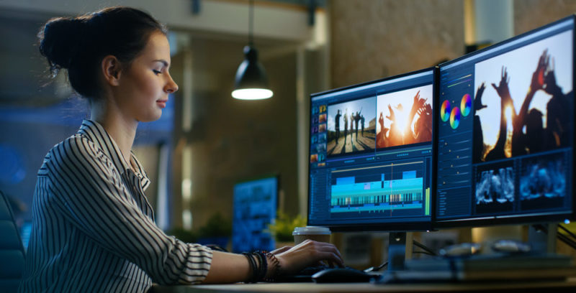
History of computing
by
Francisco David Martín Reguero

Slide 3
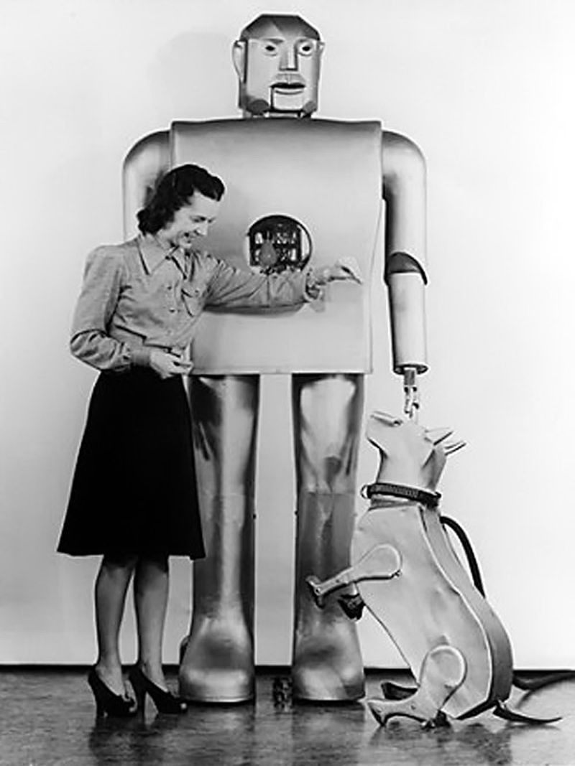
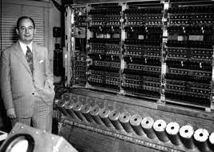

Slide 4
1938 - 1959
The first generation of computers marked a before and after in the history of computing.
Despite their limitations, these computers paved the way for future advances.
The development of the Atanasoff Berry computer and the Von Neumann architecture laid the foundation for the next generations of computers.

Slide 5
1938 - 1959
The first generation of computers marked a before and after in the history of computing.
Despite their limitations, these computers paved the way for future advances.
The development of the Atanasoff Berry computer and the Von Neumann architecture laid the foundation for the next generations of computers.

